Slide 1
AI tool for Indian Sign language(ISL) generator from audio-visual content in English to ISL content and vice-versa
PIP4004 Project
FINAL VIVA VOCE
Batch Number : CAI-G02
Under the Supervision of, Dr. Akshatha Y
Assistant Professor - Senior Scale
School of Computer Science and Engineering Presidency University
Name of the Program: CAI
Name of the HoD: Dr. Zafar Ali Khan
Name of the Program Project Coordinator: Dr. Afroz Pasha
Name of the School Project Coordinators: Dr. Sampath A K / Dr. Abdul Khadar A / Mr. Md Ziaur Rahman
Roll Number | Student Name
20211CAI0148 | Kamini Prajapathi S
20211CAI0165 | Mekala Sai Lakshmi
20211CAI0145 | Tejaswini K A

Slide 2
Introduction
The AI-powered ISL generator is designed to translate audio-visual content in English into Indian Sign Language (ISL) and vice versa. It utilizes speech recognition, natural language processing (NLP)to ensure accurate and real-time sign language translation.
The system processes spoken or textual input, converts it into ISL gestures or animations, and can also interpret ISL signs back into English using image recognition and deep learning models. This enhances communication for the deaf and hard-of-hearing community.
With applications in education, accessibility services, and media content translation, this tool aims to bridge the communication gap and promote inclusivity for sign language users in various domains.

Slide 3
Literature Review
Sign Language Recognition Techniques : Various methods, including image processing, deep learning, and computer vision, have been explored for ISL recognition. Studies highlight the use of CNNs, LSTMs for gesture detection.
Speech-to-Text & Text-to-Sign Translation : Research has focused on speech recognition systems (Google Speech API) and NLP-based text processing for converting spoken language into sign language representations.
Gesture Animation & ISL Representation : Studies emphasize dictionary-based mapping, rule-based translation, and 3D avatar-based sign animations to make ISL content more dynamic and accessible.
Challenges & Future Directions : Key challenges include regional variations in ISL, limited annotated datasets, and real-time processing constraints. Future work aims to integrate AI-powered real-time translation with AR/VR for enhanced accessibility

Slide 4
Literature Review
SL.N0 | YEAR | AUTHORS | TITLE | OUTCOMES | ADVANTANGES | DISADVANTAGES
1 | 2024 | Yadav, P., Sharma, P., Khanna, P., Chawla, M., Jain, R., & Noor | Harnessing AI to generate Indian Sign Language from natural speech and text for digital inclusion and accessibility | AI converts speech and text into ISL, improving accessibility. | Bridges Communication gaps for the deaf community | Accuracy may vary with dialects and context
2 | 2024 | Nagaraju, R., Asha, A., Vinay, A., Varun, A., Preetham, A., & Harshitha | Audio to sign language translation using AI | Converts spoken language into Indian Sign Language (ISL) for better accessibility | Helps bridge communication gaps for the deaf community | Accuracy may vary due to speech recognition errors
3 | 2021 | Kulkarni, S., & Kariyal, S. | Speech to Indian Sign Language translator | Converts spoken language into (ISL) for better accessibility | Enhances communication between the deaf and non-sign language users | Accuracy depends on speech recognition and sign database limitations
4 | 2021 | Sonawane, P., Shah, K., Patel, P., Shah, S., & Shah, J | Speech to Indian Sign Language (ISL) translation system | Converts spoken language into (ISL) for better accessibility | Helps bridge communication gaps for the deaf community | Limited accuracy due to speech recognition and sign language variations.
5 | 2021 | Tewari, Y., Soni, P., Singh, S., Turlapati, M. S., & Bhuva, A | Real-time sign language recognition framework for two-way communication | Enables seamless real-time communication between sign language users | Enhances accessibility and inclusion for the deaf community | Accuracy may be affected by varying signing styles and occlusions

Slide 5
Existing method Drawback
Limited Accuracy in Speech Recognition :Existing speech-to-text systems, often struggle with accents and background noise. This leads to inaccurate text conversion affecting the quality of sign language translation.
Static Sign Representation :ISL translation systems rely on predefined images, which fail to capture the dynamic nature of sign language. This makes communication less expressive and harder to understand compared to real-life signing.
Lack of Real-Time Processing :Many traditional systems process speech and gestures with high latency, making real-time conversation difficult.
Limited Dataset & Regional Variations :ISL lacks standardized datasets, and existing methods do not account for regional variations in gestures. This creates inconsistencies in translation, making it difficult for users.

Slide 6
Proposed Method
Real-Time Speech Recognition :The system uses Google Speech API for online and CMU Sphinx for offline speech recognition. This ensures accurate speech-to-text conversion.
NLP for Text Processing :NLP techniques filter and correct transcribed text for better accuracy. This improves word mapping to ISL signs.
Dictionary-Based Machine Translation :A predefined ISL dictionary maps words to ISL images or GIFs. This ensures correct sign representation.
User-Friendly GUI :The EasyGUI interface allows users to record speech and view sign translations. It is simple and easy to use.
Scalability and Future Expansion :The system supports an expanding ISL vocabulary and future 3D sign avatars. Machine learning may enhance real-time sign translation.

Slide 7
Features
Speech-to-Text Conversion :The system converts live speech or recorded audio into text using speech recognition. It supports both online (Google API) and offline (CMU Sphinx) modes.
ISL Image & GIF Display :Translated text is mapped to Indian Sign Language (ISL) images or GIFs. This helps users visually understand the sign representation.
User-Friendly Interface :The GUI is built using EasyGUI for simple navigation. Users can record, process speech, and view ISL signs easily.
Scalability & Future Integration :The project supports new ISL signs and phrases for continuous improvement. Future updates may include 3D animated sign avatars.

Slide 8
Methodology/Modules
Research and Analysis :Study speech-to-text and sign language translation techniques. Analyze Indian Sign Language (ISL) structure for accurate mapping.
Design :Develop a user-friendly GUI using EasyGUI for simple interaction. Focus on clear sign representation with images and GIFs.
Development :Implement Google Speech API for speech recognition. Use Python for backend and EasyGUI for frontend.
Testing :Conduct extensive testing for speech recognition accuracy. Ensure correct ISL sign mapping and smooth user experience.
Deployment :Package the system for desktop and mobile use. Provide guides for users to operate the application efficiently.
Support and Improvement :Gather user feedback for ISL dictionary expansion. Upgrade with 3D sign avatars and machine learning for better translations.

Slide 9
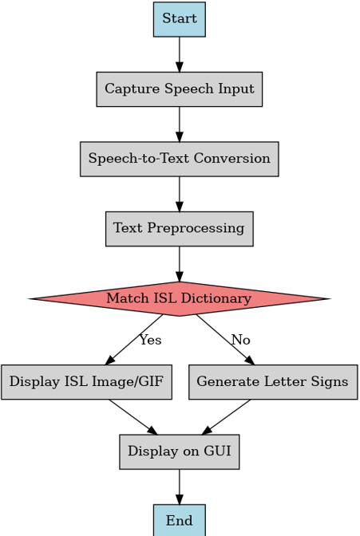
Architecture

Slide 10
Software Components
Software Requirements:
1. Programming Language:
Python 3.x: Ensure you have the latest version of Python 3 installed.
2. Libraries & Dependencies:
speech_recognition: For converting speech to text using Google API.
tkinter: For GUI development (usually comes pre-installed with Python).
easygui: For simple pop-up dialogs in the GUI.
Pillow (PIL): For handling image files.
opencv-python (cv2): For image processing and computer vision tasks.
numpy: For numerical computing and matrix manipulation.
matplotlib: For creating visualizations.
os: For interacting with the operating system and file management.
string: For string manipulation tasks.

Slide 11
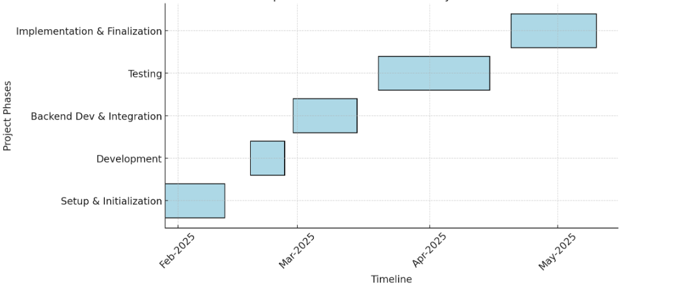
Timeline of Project

Slide 12
Expected Outcomes
Improved Communication Accessibility :Enables real-time translation of speech and text into Indian Sign Language (ISL), bridging communication gaps.
Enhanced Public Service Integration :Facilitates ISL accessibility in public services, education, and workplaces for better inclusivity.
User-Friendly and Scalable System :Features an intuitive interface with a modular design for future language expansion.
Real-Time and Offline Functionality :Supports live ISL translation and offline access for uninterrupted usage.

Slide 13
Conclusion
The Indian Sign Language (ISL) translation system aims to bridge communication barriers between the deaf community and non-sign language users. By leveraging speech recognition, NLP, and computer vision, the system provides accurate and real-time ISL translations, ensuring better accessibility in education, workplaces, and public services.
With a user-friendly interface and scalable design, the system supports both real-time and offline functionality. Its integration into various sectors will promote inclusivity and empower individuals with hearing impairments, fostering a more connected and accessible society.

Slide 14
Pseudo Code
def main():
while user_choice() == "Live Voice":
func()
exit_program()
def func():
init_speech_recognizer()
with microphone as source:
adjust_for_noise(source)

Slide 15
Pseudo Code
while True:
try:
text = clean_text(recognize_speech(listen_to_speech(source)))
if text == "goodbye": break
display_gif(text) if text in isl_gif_phrases else display_letters(text)
except: print("Could not listen")
close_display()
main()

Slide 16
Algorithm
Audio to Sign Language Translator
Start
Getting the Speech
Listen the Speech using Microphone. Now the energy threshold is already set to a good value, and we can reliably catch speech right away.
Recognise the Speech.
Convert Speech to Text.
Make the Text to lowercase for further manipulation.
Detected Text
If “goodbye” then exit. 2.Else if Detected Text in predefined Dictionary Words. Display respective GIFs of the Phrase.
Else Count the Letters of the Word/Phrase.
Display the Visual of the phrase with some delay of Actions.
Continue all the steps from Step 3, and continue till the Speech Ends.
If Error in Step 2, That is if no Speech Detected then display error message “Could not listen”

Slide 17
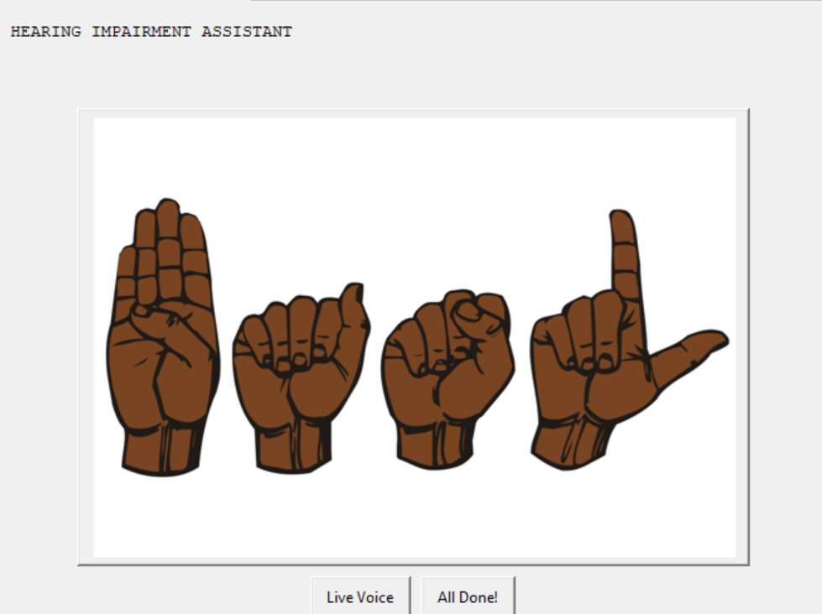
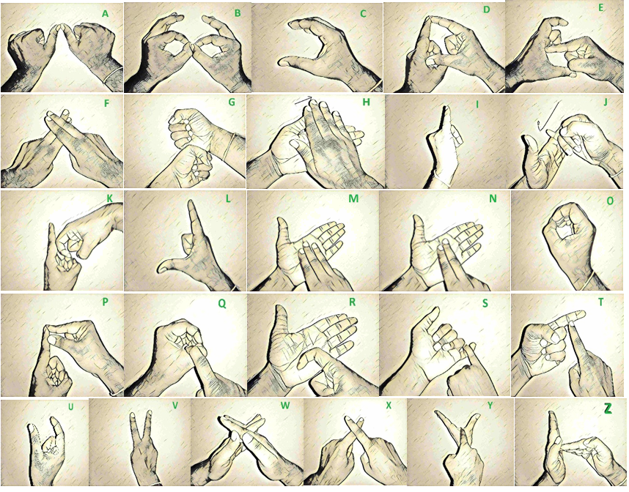
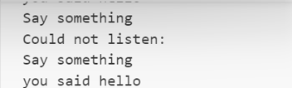
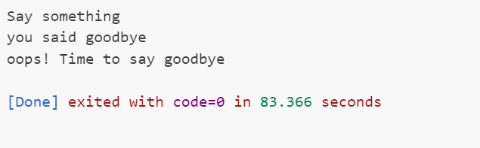
Outputs
Fig 1. Showing the hearing impairment assistant to go for Live voice
Fig 2. Showing all the Sign Alphabets from A to Z
Fig 4. Existing the Applications
Fig 3. The device responding according to the Live voice

Slide 18
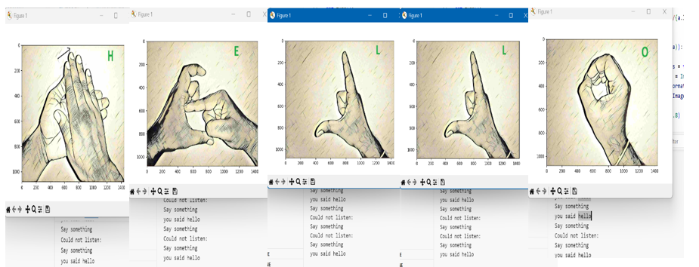
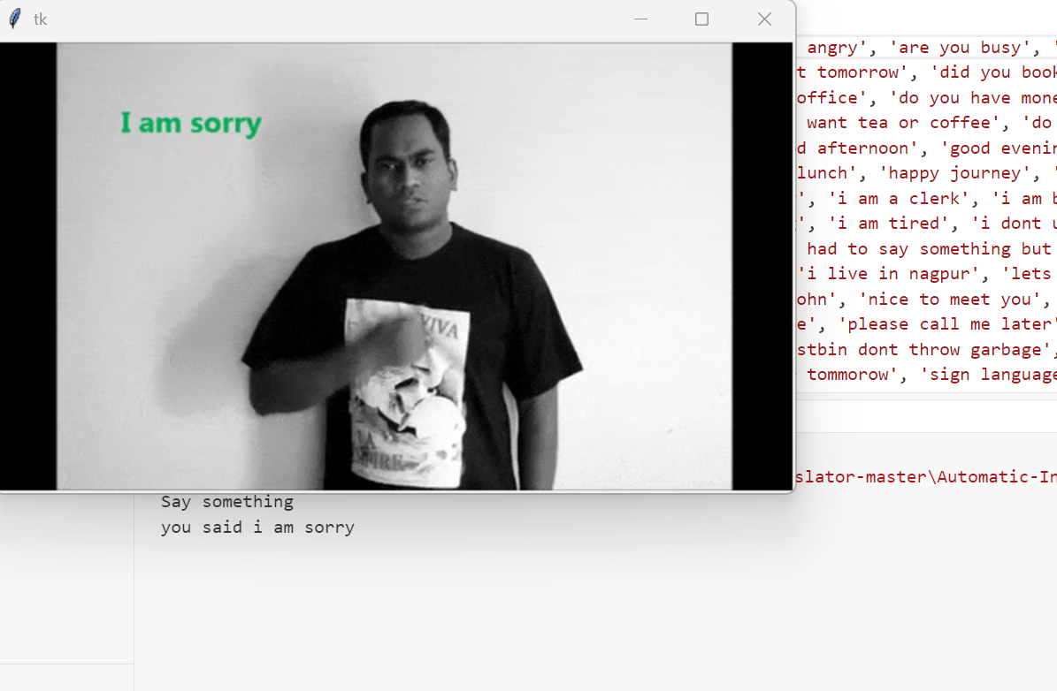
Outputs
Fig 5. According to the Live voice the device showing the sign Language
Fig 6. Example of ISL gifs according to the Live voice

Slide 19
Github Link
The Github link provided should have public access permission.
Github Link
https://github.com/katejaswini/PIP_4004

Slide 20
References
Yadav, P., Sharma, P., Khanna, P., Chawla, M., Jain, R., & Noor, L. (2024). Harnessing AI to generate Indian Sign Language from natural speech and text for digital inclusion and accessibility. International Journal of Advanced Computer Science and Applications, 15(4), 1129–1136. THESAI.ORG
Nagaraju, R., Asha, A., Vinay, A., Varun, A., Preetham, A., & Harshitha, A. (2024). Audio to sign language translation using AI. International Journal of Progressive Research in Engineering Management and Science, 4(11), 1903–1906. IJPREMS.COM
Kulkarni, S., & Kariyal, S. (2021). Speech to Indian Sign Language translator. Semantic Scholar. SEMANTICSCHOLAR.ORG
Sonawane, P., Shah, K., Patel, P., Shah, S., & Shah, J. (2021). Speech to Indian Sign Language (ISL) translation system. In Proceedings of the IEEE 2021 International Conference on Computing, Communication, and Intelligent Systems (pp. 92–96). IEEE.
Tewari, Y., Soni, P., Singh, S., Turlapati, M. S., & Bhuva, A. (2021). Real-time sign language recognition framework for two-way communication. In Proceedings of the International Conference on Communication, Information and Computing Technology (pp. 1–6). IEEE.
Kunjumon, J., & Megalingam, R. K. (2019). Hand gesture recognition system for translating Indian Sign Language into text and speech. In Proceedings of the 2019 International Conference on Smart Systems and Inventive Technology (pp. 14–18). IEEE.

Slide 21
References
Gangadia, D., Chamaria, V., Doshi, V., & Gandhi, J. (2020). Indian Sign Language interpretation and sentence formation. In Proceedings of the 2020 IEEE Pune Section International Conference (pp. 71–76). IEEE.
Shangeetha, R. K., Valliammai, V., & Padmavathi, S. (2012). Computer vision-based approach for Indian sign language character recognition. In Proceedings of the 2012 International Conference on Machine Vision and Image Processing (pp. 181–184). IEEE.
Sawant, S. N., & Kumbhar, M. S. (2014). Real-time sign language recognition using PCA. In Proceedings of the 2014 IEEE International Conference on Advanced Communication, Control and Computing Technologies (pp. 1412–1415). IEEE.
Papadogiorgaki, M., Grammalidis, N., Tzovaras, D., & Strintzis, M. G. (2005). Text-to-sign language synthesis tool. In Proceedings of the 2005 13th European Signal Processing Conference (pp. 1–4). IEEE.
Sonare, B., Padgal, A., Gaikwad, Y., & Patil, A. (2021). Video-based sign language translation system using machine learning. In Proceedings of the 2021 2nd International Conference for Emerging Technology (pp. 1–6). IEEE.
Kanvinde, A., Revadekar, A., Tamse, M., Kalbande, D. R., & Bakereywala, N. (2021). Bidirectional sign language translation. In Proceedings of the International Conference on Communication, Information and Computing Technology (pp. 1–6). IEEE.for Indian Sign Language. In Proceedings

Slide 22
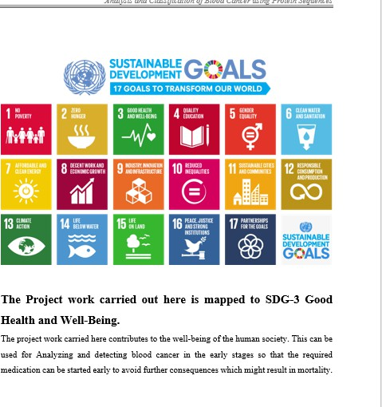
Project work mapping with SDG
Good Health and Well-Being(3)
Quality Education (4)
Gender Equality (5)
Decent Work and Economic Growth (8)
Reduced Inequalities (10)
Sustainable Cities and Communities (11)
Peace, Justice, and Strong Institutions(16)
Partnerships for the Goals(17)

Slide 23
Thank You

